Slide 1
Concept Selection
Teaching materials to accompany:
Product Design and Development
Chapter 8
Karl T. Ulrich and Steven D. Eppinger
5th Edition, Irwin McGraw-Hill, 2012.

Slide 2
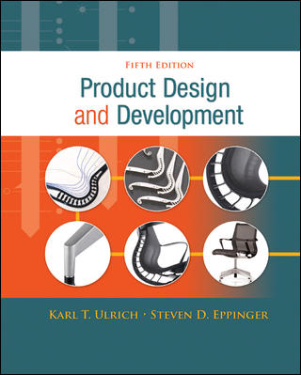
Product Design and Development
Karl T. Ulrich and Steven D. Eppinger
5th edition, Irwin McGraw-Hill, 2012.
Chapter Table of Contents:
Introduction
Development Processes and Organizations
Opportunity Identification
Product Planning
Identifying Customer Needs
Product Specifications
Concept Generation
Concept Selection
Concept Testing
Product Architecture
Industrial Design
Design for Environment
Design for Manufacturing
Prototyping
Robust Design
Patents and Intellectual Property
Product Development Economics
Managing Projects

Slide 3
Concept Development Process
Mission
Statement
Identify
Customer
Needs
Establish
Target
Specifications
Generate
Product
Concepts
Select
Product
Concept(s)
Test
Product
Concept(s)
Set
Final
Specifications
Plan
Downstream
Development
Development
Plan
Perform Economic Analysis
Benchmark Competitive Products
Build and Test Models and Prototypes

Slide 4
Outline
Introduction to product concept selection
Commonly dysfunctions in product development
Product concept selection process

Slide 5
Definition
Product concept selection is a decision process, in which the design team selects one or a few product concept for further development

Slide 6
Challenges
How to choose the best concept of abstraction?
How to embrace all inputs (likings and concerns) from the whole team in the decision process?
How to make use of good attributes of otherwise weak concept designs?
How to document the decision process?

Slide 7
Concept Selection Approaches
External decision
  By use of an external group of customers, clients, etc.
Product champion & intuition
  By an influential member of the development team
Multi-voting
  Asking each member to pick a number of concepts and pick the one with most votes.
Pros and cons
  The team list the strengths and weakness of each concept.
Prototype and test
  Build and test prototype for each concept and select based on the test data.
Decision metrics
  The team rates each concept against selection criteria with varying importance/weights.

Slide 8
Two stages of concept selection
Concept screening (the Pugh concept selection method)
  To quickly narrow the number of concepts and to improve the concepts
Concept scoring
  weighs the relative importance of the selection criteria
  focus on more refined comparisons with respect to each criteria

Slide 9
Concept Selection Process
Prepare the Matrix
  Criteria
  Reference Concept
  Weightings
Rate Concepts
  Scale (– 0 +) or (1–5)
  Compare to Reference Concept or Values
Rank Concepts
  Sum Weighted Scores
Combine and Improve
  Remove Bad Features
  Combine Good Qualities
Select the Best Concept
  May Be More than One
  Beware of Average Concepts
Reflect on the Process
  Continuous Improvement

Slide 10
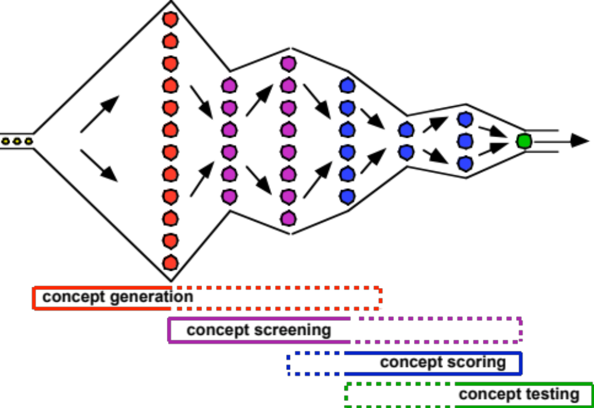
Concept Development Funnel

Slide 11
Remember…
The goal of concept selection is not to
Select the best concept.
The goal of concept selection is to
Develop the best concept.
So remember to combine and refine the concepts to develop better ones!

Slide 12
Caveats
• Beware of the best "average" product.
• Perform concept selection for each different customer group and compare results.
• Check sensitivity of selection to the importance weightings and ratings.
• May want to use all of detailed requirements in final stages of selection.
• Note features which can be applied to other concepts.

Slide 13
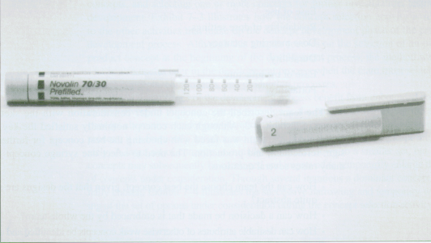
Concept Selection Example:
Reusable Syringe

Slide 14
Mission Statement
Product description:
  Reusable syringe with precision dosage control for outpatient use.
Primary market
  Elderly
Major features:
  Accuracy of dose metering
  Inexpensive

Slide 15
Need analysis
Ease of handling
Ease of use
Readability of dose settings
Accuracy of dose metering
Durability
Ease of manufacture
Portability

Slide 16
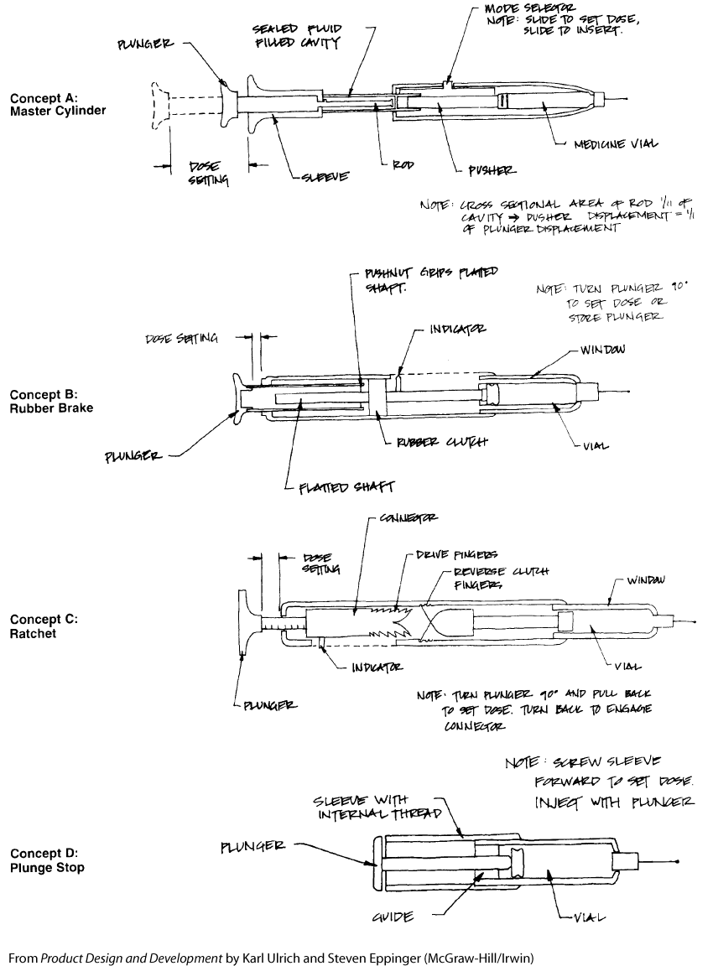

Slide 17
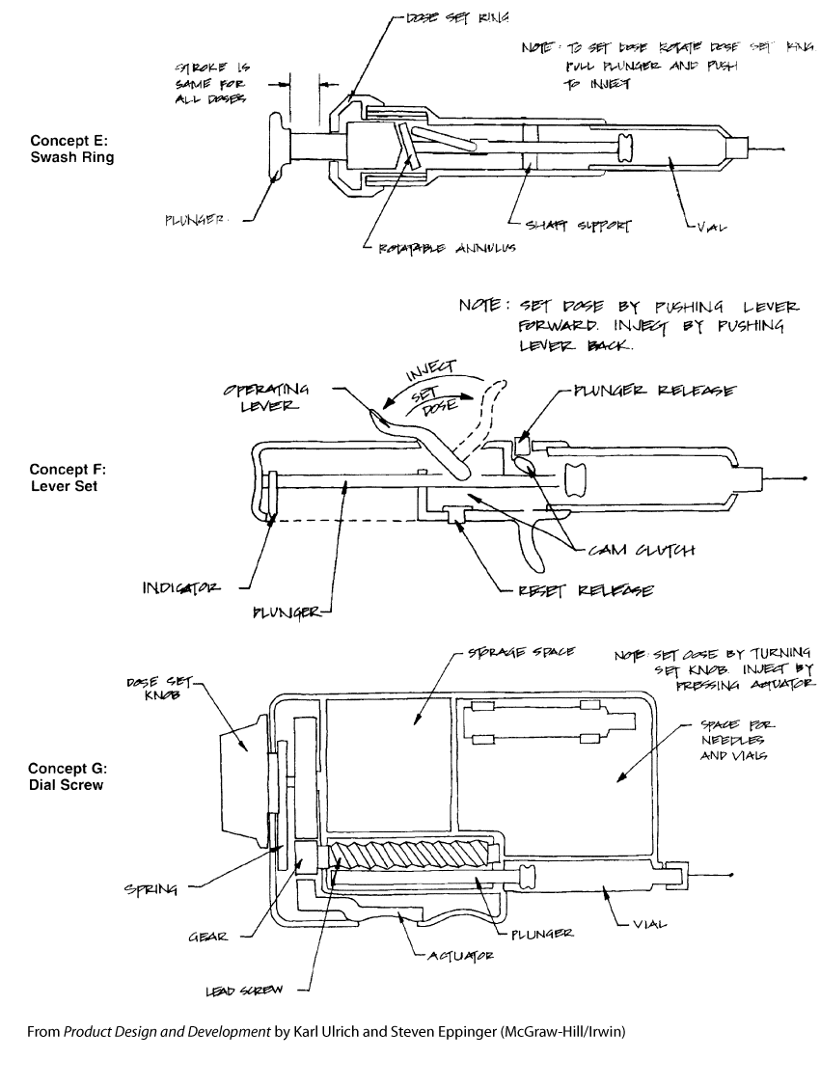

Slide 18
Concept screening steps
Prepare a selection matrix based on the selection criteria
Rate the concepts
Rank the concepts
Combine and improve concepts
Select one or more concepts
Reflect on the results and the process

Slide 19
Concept screening principles
Be focused on customer needs
Match or exceed competitors’ performance along key dimensions
Improve the product’s manufacturability
Reduce lead time
Encourage more and effective participation from the design team members
Have better documentation of the decision process.

Slide 20
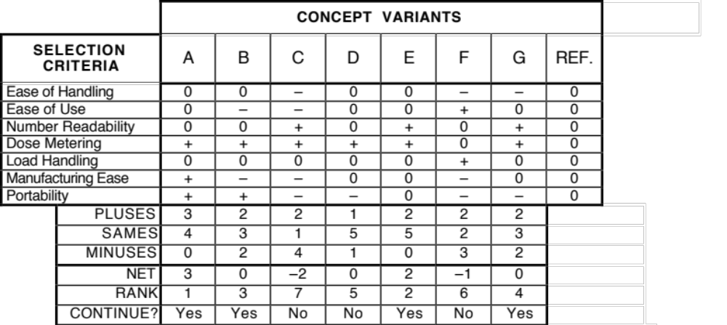
Example: Concept Screening

Slide 21
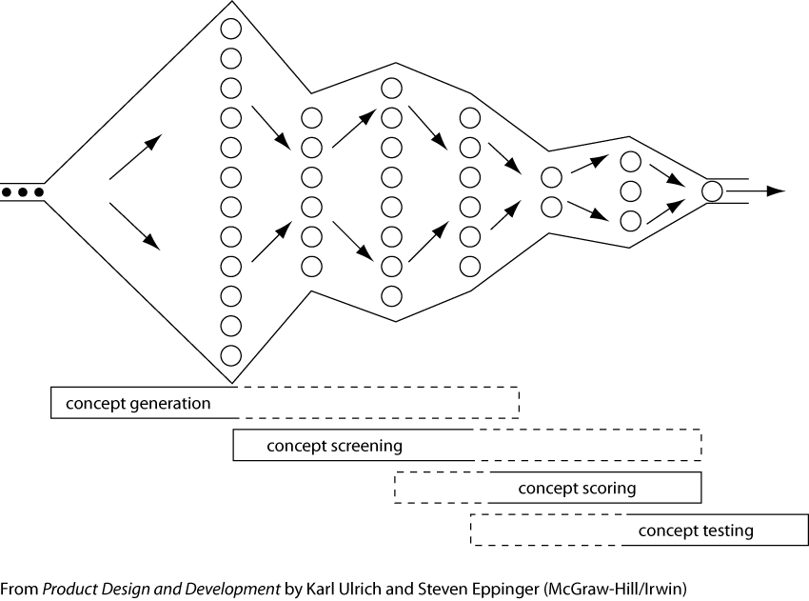

Slide 22
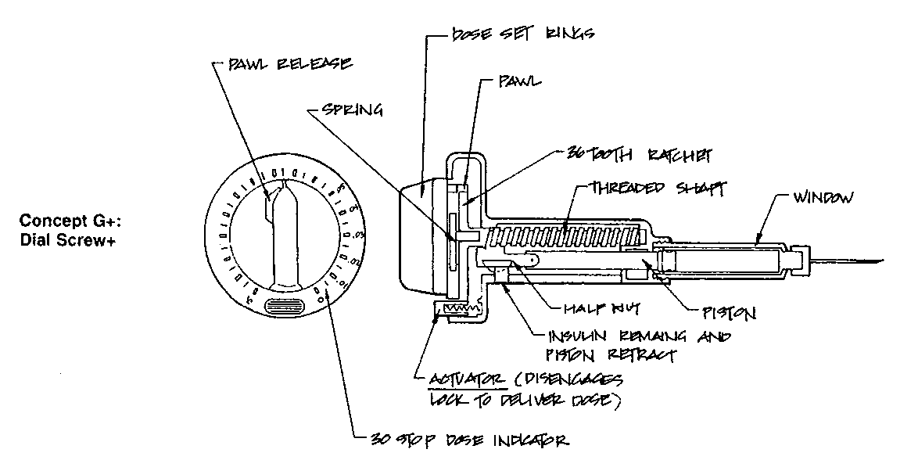

Slide 23
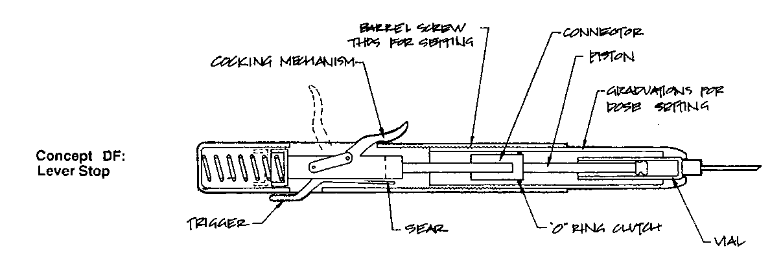

Slide 24
Concept scoring steps
Prepare a selection matrix, based on the selection criteria
Rate the concepts
Rank the concepts
Combine and improve concepts
Select one or more concepts
Reflect on the results and the process

Slide 25
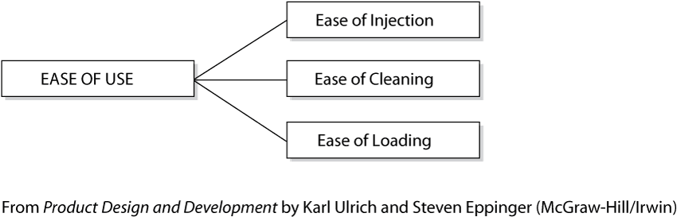

Slide 26
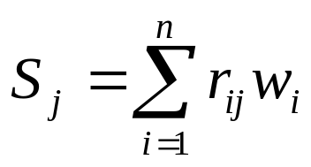
Concept Scoring Method
  where
    w_{i} = the weight for the ith criterion
    r_{ij} = raw rating of concept j for the ith criterion

Slide 27
Scale for Rating the Concepts
(relative performance)
1: much worse than the reference
2: worse than the reference
3: same as the reference
4: better than the reference
5: much better than the reference

Slide 28
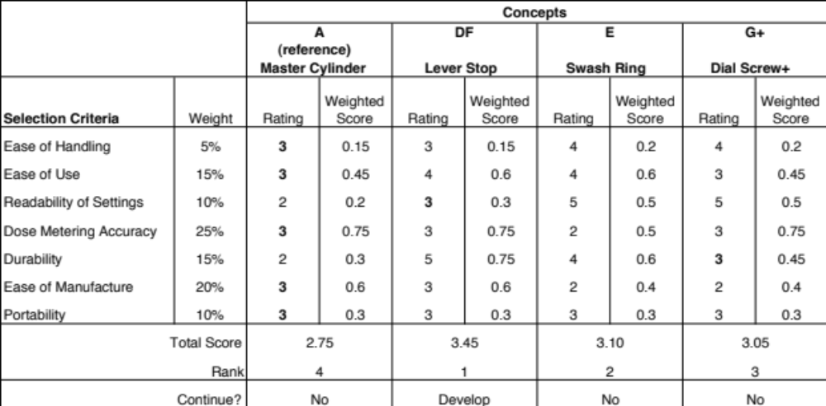
Example: Concept Scoring

Slide 29
Issues in the decision process
It assumes that the selection criteria reflect customer’s needs
It assumes that the selection criteria are independent
Manufacturing costs and manufacturability are not included in the decision
It is better to directly evaluate those independent, simpler concepts underpinning the design concepts, if they constitute all the product concepts.
The process of concept selection can be applied to throughout the development process.

Slide 30
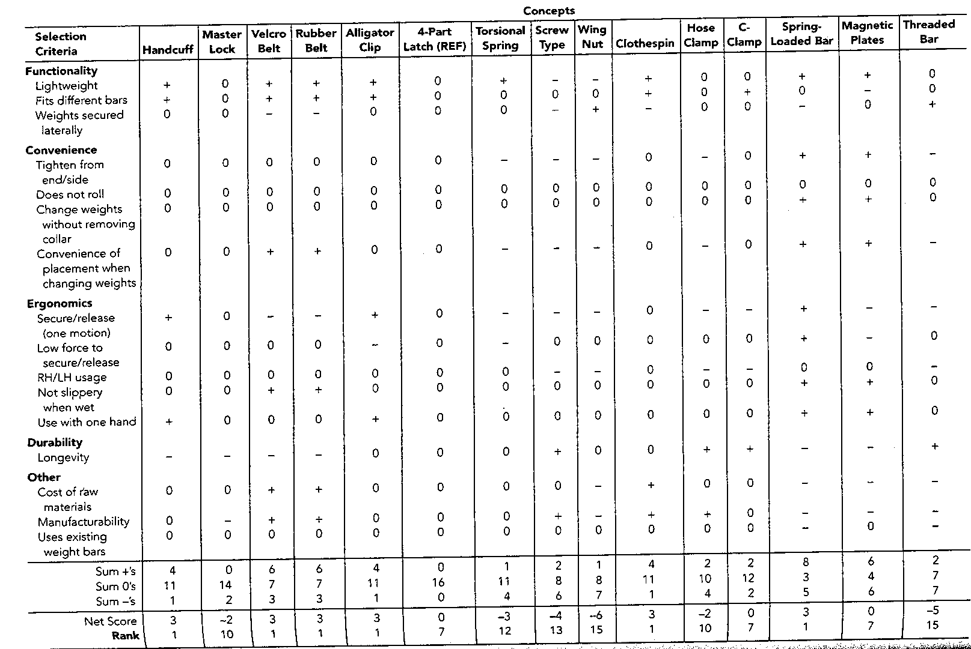

Slide 31
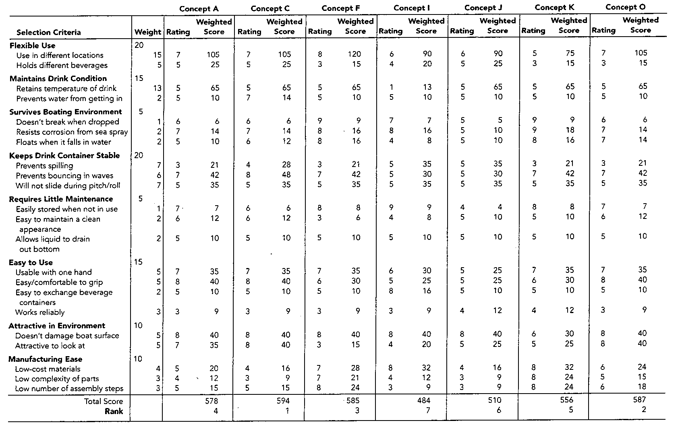

Slide 32
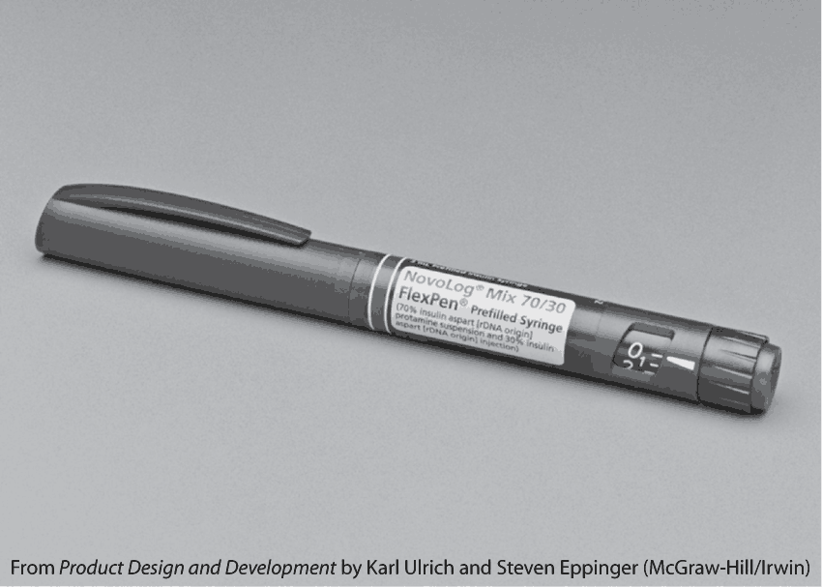

Slide 33
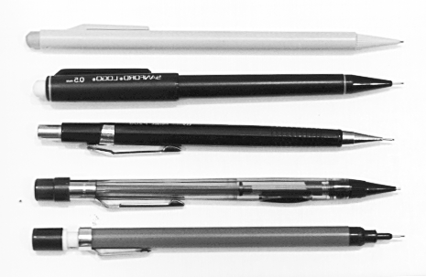
Concept Selection Exercise:
Mechanical Pencils

Slide 34
Mechanical Pencils:
Customer Needs

Slide 35
Mechanical Pencils:
Concept Selection Matrix

Slide 36
Retail Prices of Five Pencils
Classic $2.75
Quick Click $2.58
Twist Erase $2.08
Zézé $0.90
Bic $0.33

Slide 37
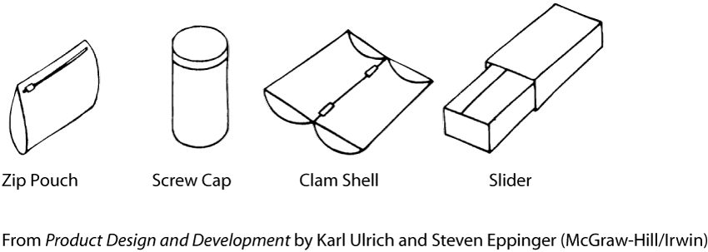
What are the screening and scoring criteria for the following pencil holder concepts?

Slide 38
Other Images

Slide 40
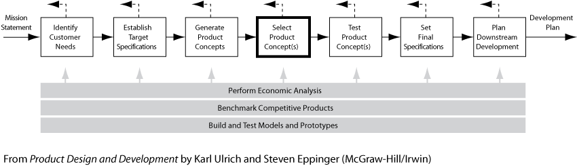

Slide 43
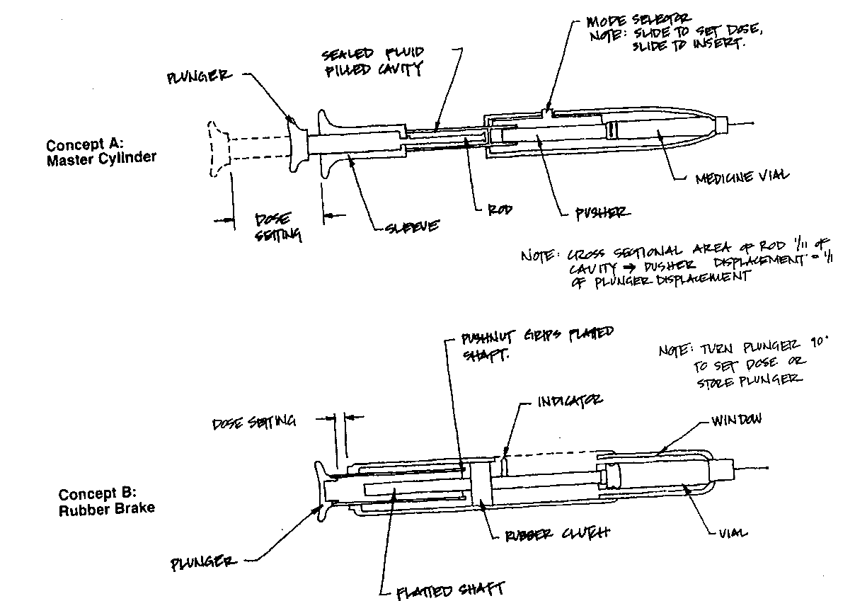

Slide 44
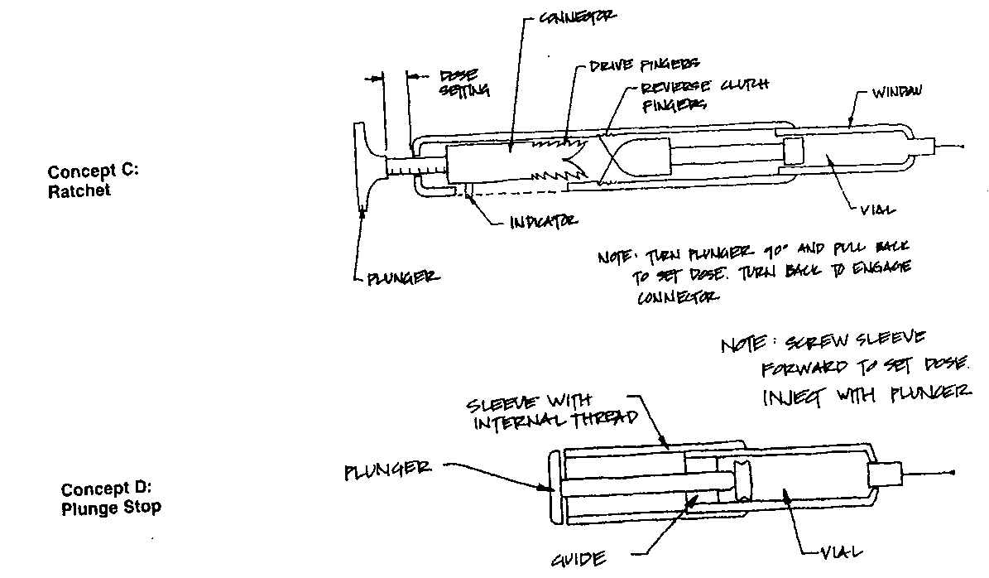

Slide 45
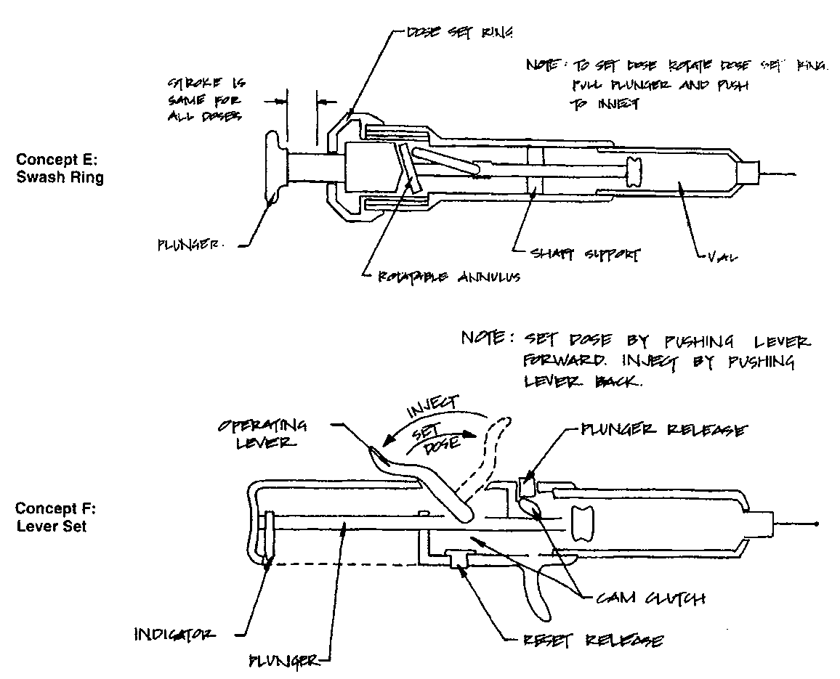

Slide 46
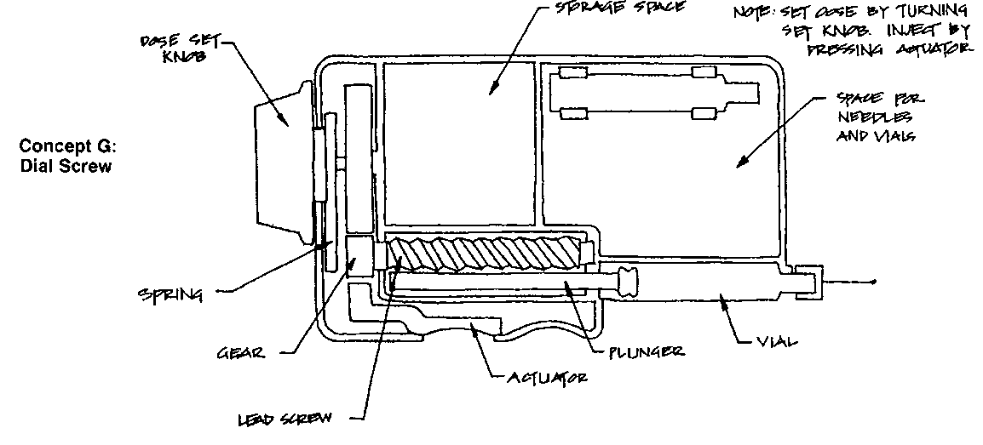

Slide 47
